Slide 1
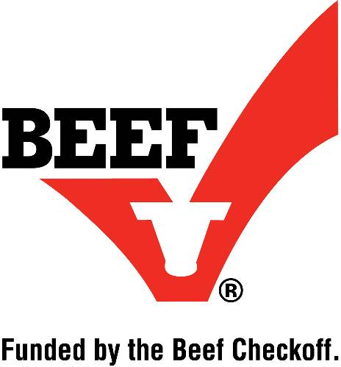
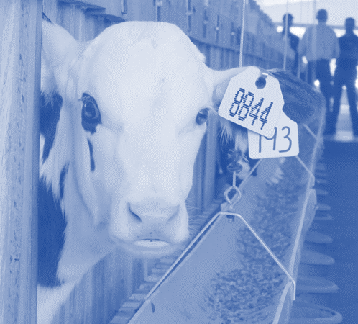
EDUCATIONAL PROGRAM PRESENTATION
Demonstrating the industry’s ongoing commitment to producing safe, nutritious, humanely-raised veal for their customers
Notes:
Welcome to this educational presentation to assist you in your efforts to become Veal Quality Assurance certified. This presentation addresses key information and Best Management Practices outlined in the certification manual. There will be an exam at the end of this presentation and all questions in the exam will be addressed in the presentation that follows.
The VQA program was created in 1990 to certify producers in humane care methods, general animal husbandry practices and the regulatory requirements that govern veal production. This current edition was reviewed and updated by a Technical Advisory Group in 2017. The training and certification materials were released to the industry in 2018.

Slide 2
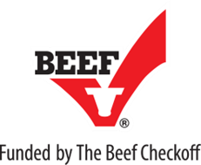
PROGRAM OVERVIEW
Funded by The Beef Checkoff
Administered by the North American Meat Institute
For more information: www.VealFarm.com
Notes:
The VQA program is funded by The Beef Checkoff.
Every beef and veal farmer, and every beef or veal importer, contributes to a fund called the national beef checkoff, which is used to support the Veal Quality Assurance Program. This program is administered by the North American Meat Institute, a contractor to the beef checkoff.

Slide 3
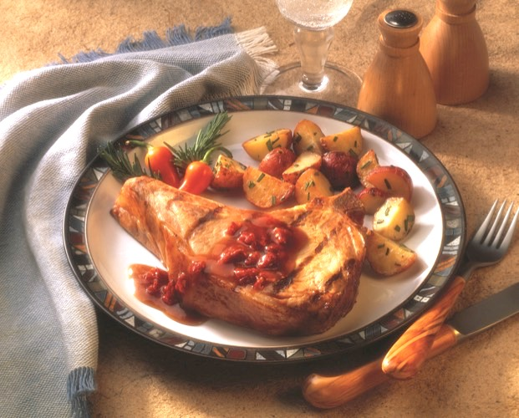
PROGRAM OVERVIEW
The goal of the Veal Quality Assurance (VQA) program is to inspire consumer trust and confidence in milk-fed veal and to demonstrate the industry’s ongoing commitment to producing safe, nutritious, humanely-raised veal for your customers.
Notes:
Today more than ever, consumers seek information about how their food is produced. Their interest in food goes beyond taste, nutrition, convenience and price. They desire to know how and where their food was produced, and who was involved. Most importantly, they want to know if the process and the people engaged can be trusted, and if the food reflects their values.
The Center for Food Integrity consumer research indicates 65 percent of consumers want to know more about farming and how their food is produced.
The goal of the Veal Quality Assurance (VQA) program is to inspire consumer trust and confidence in milk-fed veal and to demonstrate the industry’s ongoing commitment to producing safe, nutritious, humanely-raised veal for their customers. Simply put, consumers, food service and retail managers, and policy makers deserve to know that they can count on the veal industry to do what’s right and for the right reasons.

Slide 4
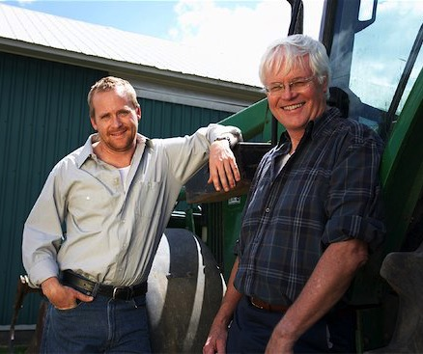
PROGRAM OVERVIEW
VQA provides educational resources and Best Management Practices to ensure every veal farmer and those who care for veal calves meet the obligations and responsibilities inherent to raising animals for food.
Notes:
The VQA program is a collection of science-based best practices and standards developed by farmers, veterinarians and other industry experts to ensure that veal calves receive quality care through every stage of life and are raised using production standards that result in a safe, wholesome, high quality product that meets regulatory and customer expectations. Specifically, VQA is designed to address all aspects of animal care and on-farm practices that will enhance veal calf well-being and veal quality.
The VQA program – the presentation and the manual -- provide veal farmers and industry leaders with the educational resources to develop and follow a comprehensive herd health plan and calf care program dedicated to producing consistent and exceptional quality veal. It also helps identify potential problem areas and solutions to ensure that every veal farmer meets the obligations and responsibilities inherent in raising animals for food.
Items labeled as Best Management Practices are the key elements which must be met to receive VQA certification. The rest of the information and guidelines in the manual are resources to assist in meeting the requirements of VQA.

Slide 5
PROGRAM OVERVIEW
The Veal Quality Assurance program does not tolerate abusive behavior towards animals. Any questionable behavior should be reported immediately to farm management and local authorities.
Notes:
The VQA program provides veal farmers and industry leaders with the educational resources to develop and follow a comprehensive herd health plan and calf care program dedicated to producing consistent and exceptional quality veal. It also helps identify potential problem areas and solutions to ensure that every veal farmer meets the obligations and responsibilities inherent in raising animals for food.
The Veal Quality Assurance program does not tolerate abusive behavior of animals. Any questionable behavior should be reported immediately to farm management and local authorities.

Slide 6
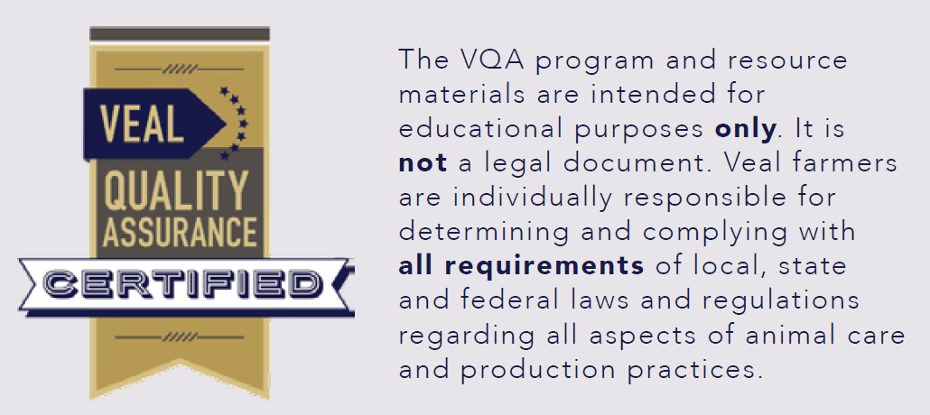
PROGRAM OVERVIEW
Notes:
The VQA program and resource materials are intended for educational purposes only. It is not a legal document. Veal farmers are individually responsible for determining and complying with all requirements of local, state and federal laws and regulations regarding all aspects of animal care and production practices.

Slide 7
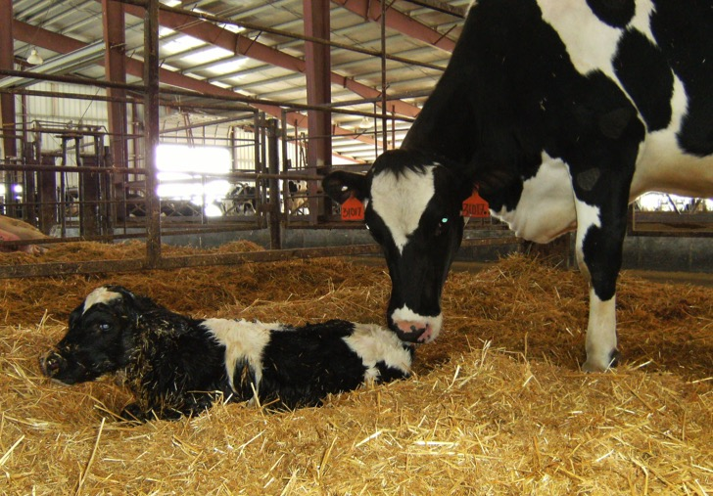
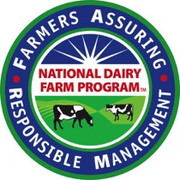
PROGRAM OVERVIEW
Success starts at the dairy farm
Notes:
The success of all calves entering the veal market is highly dependent on early care at the dairy farm. The same principles of calf care used for dairy heifers should be applied to the care of bull calves, regardless if they are entering the beef or veal market. The U.S. veal industry is comprised of two major markets, milk-fed veal and bob veal.
Approximately 85% of the veal produced in the U.S. is formula-fed veal. These calves are marketed around six months old (approximately 450-500 pounds) and consume milk grain and some roughage, which makes them very different than their bob veal counterparts. The VQA program provides best management practices for producing milk-fed veal.
Less than 10% of the total volume of all veal produced in the U.S. is bob veal. Bob veal calves are usually sold directly from the dairy farm to a meat processor/packer or through a sale barn to a meat processor for harvesting. Calves typically weigh less than 150 pounds. Dairy farmers should be very careful not to use medications that can cause residues. Dairy farmers should refer to and follow the best management practices for new born calves and dairy beef outlined in the National Dairy FARM program.

Slide 8
PROGRAM OVERVIEW
Page
VQA Manual
6
Guiding Principles
Food Safety:
Producing safe and nutritious food is our first responsibility
Animal Care:
We have an ethical obligation to provide appropriate care for our animals at every stage of life
Notes:
The VQA Certification Manual outlines Ethical Standards and Code of Conduct for the U.S. Veal Industry (page 6) which was adopted by the American Veal Association (AVA) in 2010. While all aspects of the Guiding Principles are important, the first two are most significant for the Veal Quality Assurance program.
Food Safety: Producing safe and nutritious food is our first responsibility
Veal farmers are expected to:
Adopt on-farm and management practices consistent with producing safe food
Adopt animal care practices consistent with producing safe food
Use animal health products judiciously
Continually review practices for improvements that protect food safety
Animal Care: We have an ethical obligation to provide appropriate care for our animals at every stage of life
Veal farmers are expected to:
Safeguard and promote the health and well-being of animals in their care
Provide appropriate water, food, shelter, handling and transportation at all times
Respect the special considerations and needs of young calves
Provide appropriate veterinary care at all stages of life, and when necessary, timely euthanasia.

Slide 9
Chapter 1
Page
VQA Manual
8
Program Components and Requirements
Maintain a Veterinarian/Client/Patient/Relationship
(Appendix A)
Adhere to the best management practices outlined in each section of the VQA manual
(Appendix B)
Notes:
What are the program components and requirements for Veal Quality Assurance Certification? They are outlined on Page 8 of the manual. As we continue the presentation, you will see page numbers referenced in the upper right corner of the slide.
Now here are the requirements to be VQA certified:
Maintain a Veterinarian/Client/Patient/Relationship (Appendix A)
Adhere to the best management practices (Appendix B) outlined in each section of the VQA manual

Slide 10
Chapter 1
Page
VQA Manual
7
Program Components and Requirements
Best Management Practices
• Animal Health
• Feed and Nutrition
• Housing and Facilities
• Handling and Transportation
• Overall Management
Notes:
The Best Management Practices include the following subject areas:
• Animal Health
• Feed and Nutrition
• Housing and Facilities
• Handling and Transportation
• Overall Management
Today’s presentation will outline details in each of these areas.

Slide 11
Chapter 1
Page
VQA Manual
8
Program Components and Requirements
Have a licensed veterinarian assess and provide documentation that Best Management Practices are being followed
(Appendix C)
Notes:
The next requirement is to have a licensed veterinarian (preferably the one identified in their VCPR) assess and provide documentation that Best Management Practices are being followed (Appendix C)

Slide 12
Chapter 1
Page
VQA Manual
8
Program Components and Requirements
Participate in a VQA educational presentation by an industry representative, and document completion of the training
Complete and pass a VQA test following the educational presentation
The exam will be provided after the presentation today
Notes:
Another requirement is to participate in a VQA educational presentation by an industry representative, and document completion of the training.
Next, complete and pass a VQA test following the educational presentation. Everyone participating in this presentation will receive the examination after today’s session.

Slide 13
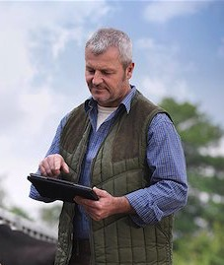
Chapter 1
Page
VQA Manual
8
Program Components and Requirements
Continually review practices for ongoing improvement and innovation on the farm
Re-certification is required every three years
Notes:
The VQA program also requests that farmers and veterinarians continually review practices for ongoing improvement and innovation on the farm.
Re-certification is required every three years.

Slide 14
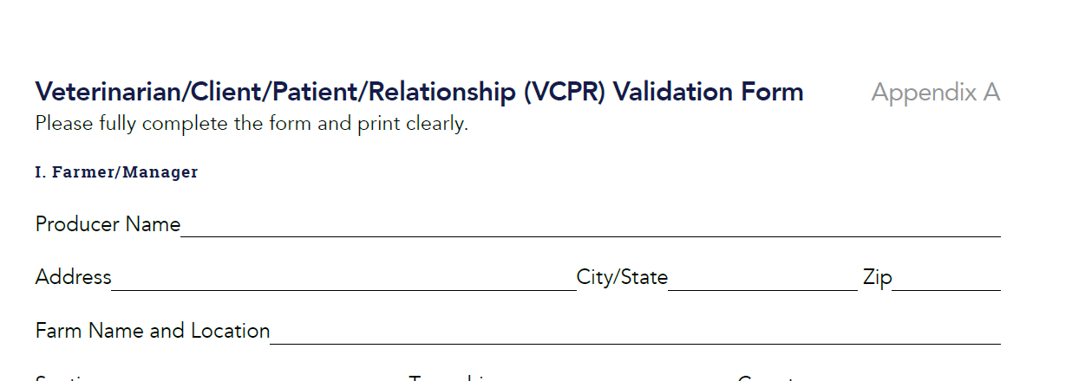
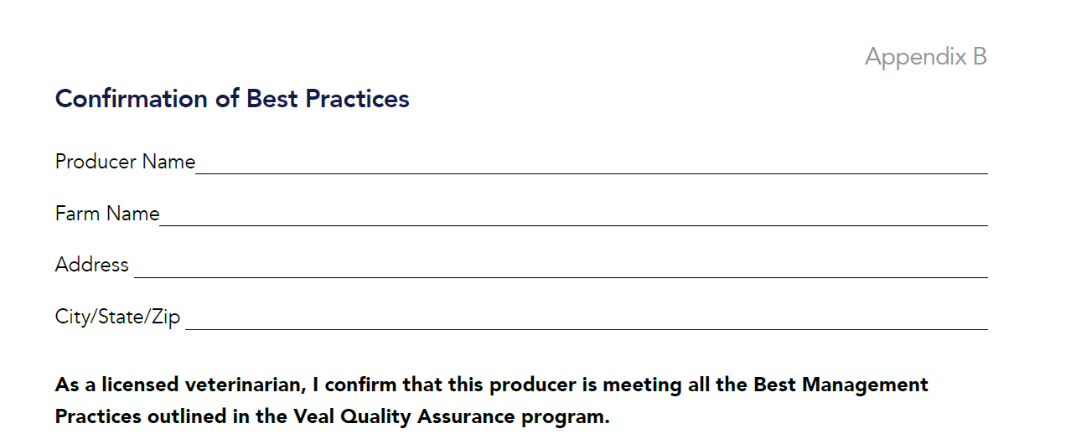
Documentation to Submit – 1 set per farm
Submit these three forms
A – B – C
Print clearly
Complete fully
Include pages to
41
46
Notes:
Now I will review the documentation to submit for certification; Those items include:
Veterinarian/Client/Patient/Relationship (Appendix A)
Completed Best Management Practices Assessment (Appendix B) (B is multiple pages) and arrangements will need to be made to have a veterinarian complete this assessment with you.
Complete the Certification Confirmation form (Appendix C) (signature is required by the producer and the veterinarian)
While I am here as an industry/company representative to present this educational information and administer the test, a veterinarian’s signature is needed for these documents to be complete. I will speak with each of you after the presentation to help coordinate these final steps and gather the documents to be submitted for certification.

Slide 15
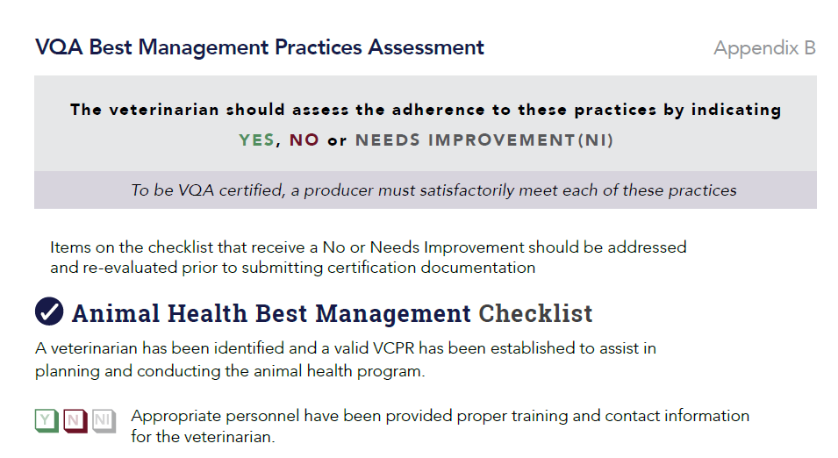
Documentation to Submit – 1 set per farm
42
Important Reminders – Page in the manual
Items on this checklist that receive a
No or Needs Improvement should be addressed prior to submitting for certification
Notes:
The VQA Best Management Practices Assessment begins on page 42 and continues to page 45. This assessment is to measure adherence to the practices. To be VQA certified, a producer must satisfactorily meet each of these. Items on this checklist that receive a NO or NEEDS IMPROVEMENT should be addressed and re-evaluated prior to submitting for certification. This is the assessment that requires the involvement of your veterinarian.

Slide 16
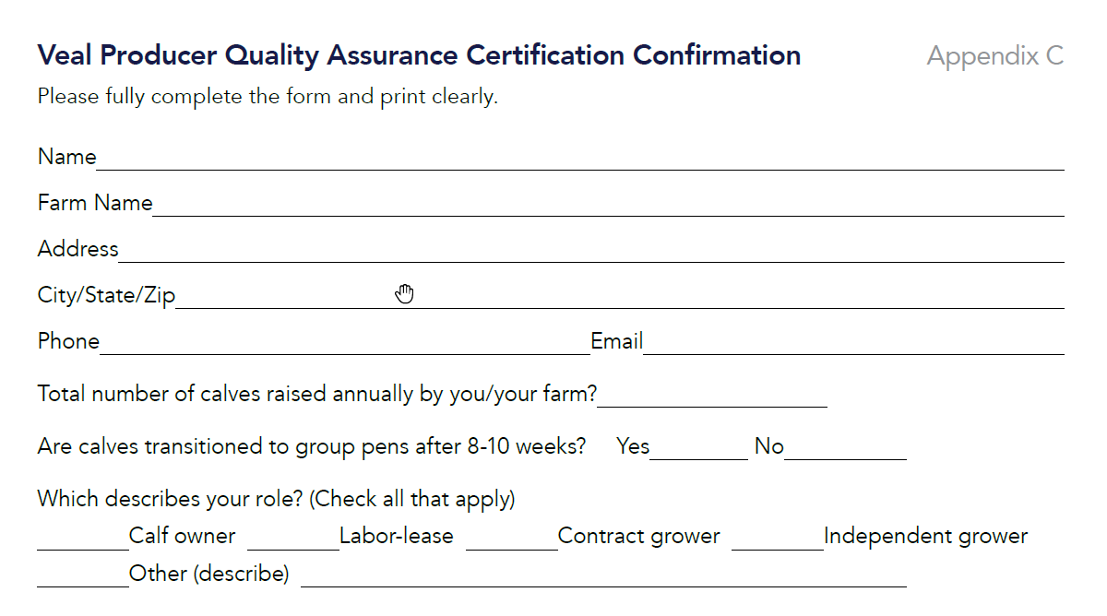
Documentation to Submit – 1 set per farm
46
Important Reminders – Page in the manual
Total number of calves raised annually
Transitioned to group pens…?
Notes:
Besides printing clearly and it is important to complete the forms fully.
Make note that we are asking for the total number of calves raised annually. This can be an estimate. It is extremely helpful to determine how many milk-fed veal calves are coming from VQA certified farms.
We also want to assess if everyone raising milk-fed veal calves has transitioned to group pens.

Slide 17
Documentation to Submit – 1 set per farm
Submit these three forms
A – B – C
1 set per farm
Include additional names of those who have completed the training on page
46
Make 2 copies
Send one set to:
Notes:
Multiple people from one farm can and should participate in the training here today and take the exam. However, one set of documentation is all that is needed per farm.
Additional names of those who attended the educational presentation can be listed on Page 46 of Appendix C.
I will make 2 copies of everything. We will keep a copy and mail a copy to meet the VQA requirements.

Slide 18
WHAT QUESTIONS DO YOU HAVE?
Purpose
Background
Funding and Management
Requirements
Documentation to submit
UP NEXT: Chapter 2 Animal Health
Notes:
Before we move further, what questions do you have on what has been covered so far?
Up Next: Chapter 2 Animal Health

Slide 19
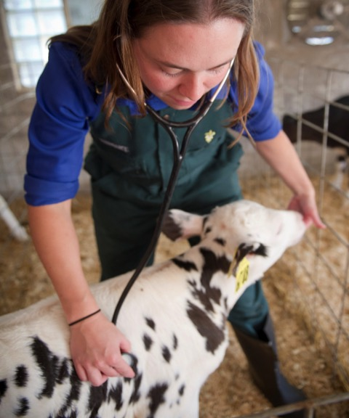
Chapter 2
Page
VQA Manual
11
Best Management Practices
Calf health is a team effort
Notes:
Let’s move to Chapter 2, Animal Health
Calf Health is a Team Effort
A healthy calf is a priority at the farm. Veal calves have special animal health needs as young calves have not developed a strong defense system and are more prone to challenges associated with stress.
Veal farmers have an ethical obligation to provide each animal with appropriate quality care through each stage of life. This can best be achieved by establishing on-farm protocols and training that seek to maximize animal health while minimizing stress, disease and pain. In conjunction with providing essential nutrition, access to water, and a clean, comfortable environment, timely and appropriate response to treating sickness or disease is important. By working directly with a veterinarian to establish a comprehensive herd-health program, veal farmers are able to provide quality animal care, prevent disease and determine the best option for addressing any animal health concern.

Slide 20
Chapter 2
Page
VQA Manual
11
Best Management Practices
A veterinarian has been identified and a valid VCPR has been established to assist in planning and conducting the animal health program.
Veterinarian-Client-Patient-Relationship (VCPR)
Appendix A
Notes:
Establish a Veterinarian-Client-Patient Relationship (VCPR) (Appendix A) is a Best Management Practice
To diagnose, treat and mange herd health, farmers must establish a veterinarian/client/patient relationship (VCPR) with a licensed veterinarian.

Slide 21
Chapter 2
Page
VQA Manual
12
Valid VCPR is one in which:
1) A veterinarian has assumed the responsibility for making medical judgments regarding the health of (an) animal(s) and the need for medical treatment
2) There is sufficient knowledge of the animal(s) by the veterinarian
3) The practicing veterinarian is readily available
Notes:
A valid veterinarian-client-patient relationship is one in which:
(1) A veterinarian has assumed the responsibility for making medical judgments regarding the health of (an) animal(s) and the need for medical treatment, and the client (the owner of the animal or animals or other caretaker) has agreed to follow the instructions of the veterinarian;
(2) There is sufficient knowledge of the animal(s) by the veterinarian to initiate at least a general or preliminary diagnosis of the medical condition of the animal(s); and
(3) The practicing veterinarian is readily available for follow-up in case of adverse reactions or failure of the therapy regimen.
Such a relationship can exist only when the veterinarian has recently seen and is personally acquainted with the keeping and care of the animal(s) by virtue of examination of the animal(s), and/or by medically appropriate and timely visits to the premises where the animal(s) are kept.

Slide 22
Chapter 2
Page
VQA Manual
11
Best Management Practices
Appropriate personnel have been provided proper training and contact information for the veterinarian.
A training manual for this should be developed, training by employees should be documented in this manual and it should be kept on site.
Notes:
It is a Best Management Practice to provide training to all farm employees that work with the care and feeding of the calves. Specifically, appropriate personnel should receive proper training and contact information for the veterinarian. A training manual for this should be developed, training by employees should be documented in this manual and it should be kept on site.
There are a number of times throughout the manual when training is recommended for employees. You may use this manual as a resource in addition to information provided by your feed company, veterinarian or farm manager to create and provide training to employees.

Slide 23
Chapter 2
Page
VQA Manual
11
Best Management Practices
All medications and other AHCPs used are labeled to meet the requirements of the Food and Drug Administration.
Treatment protocols should be in a notebook and kept on site. Everyone having access follows the farm’s record keeping system, follows the label information and understands the methods for keeping records.
Notes:
The next Best Management Practice relates to Animal Health Care Products.
All medications and other AHCPs used are labeled to meet the requirements of the Food and Drug Administration.
Treatment protocols should be in a notebook and kept on site.
Everyone having access to the medications is familiar with the farm’s record keeping system, follows the information on the medication label and knows the importance and methods of keeping accurate records. This should be documented in the training manual.

Slide 24
Chapter 2
Page
VQA Manual
13
FDA Label Information on Bottle or Container
Name and address of the veterinarian or other source
Active ingredients in the product
Species for which the drug is approved
Diseases or conditions for which the drug is approved
Directions for use including dosage, frequency, route of administration and how long the treatment should be administered
The specified withdrawal time and expiration date for the product
Any cautions or warnings by the veterinarian
Notes:
The FDA requires that medications used at the farm must have the following information contained on the label of each bottle or container.
Name and address of the veterinarian or other source
Active ingredients in the product
Species for which the drug is approved
Diseases or conditions for which the drug is approved
Directions for use including dosage, frequency, route of administration and how long the treatment should be administered
The specified withdrawal time and expiration date for the product
Any cautions by the veterinarian, such as not using the medication with other specified medications or compounds (including warnings about possible adverse reactions)

Slide 25
Chapter 2
Page
VQA Manual
12
Administering Animal Health Care Products (AHCP)
Oral – as a drench, bolus or pill
Subcutaneous (SQ) – beneath the hide on the side of the neck only
Intramuscular (IM) – neck muscles only
Intravenous (IV) – in the jugular vein (neck)
Topical – applied to the outside of the hide (usually along the back)
Notes:
Administering Animal Health Care Products
There are several methods by which medications can be administered. (Appendix D) Subcutaneous (SQ) administration is the preferred method if the AHCP is labeled for Intramuscular (IM) or SQ administration. Injections should be limited to 5 cc per IM injection site. No more than 10 cc of the AHCP should be deposited in one site if SQ administration is used.

Slide 26
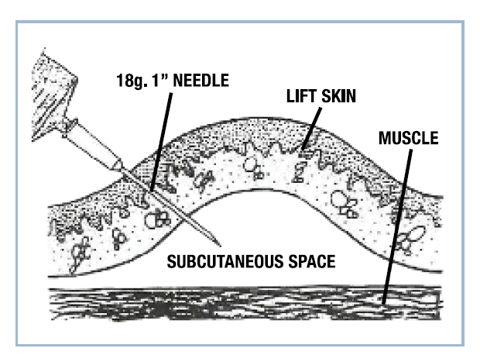
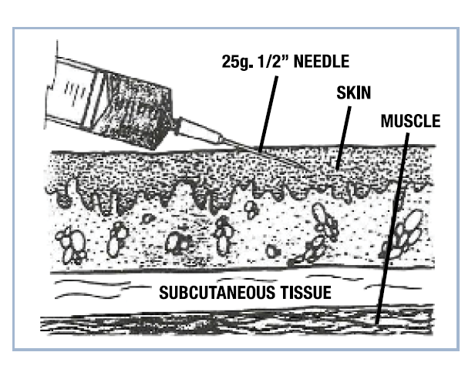
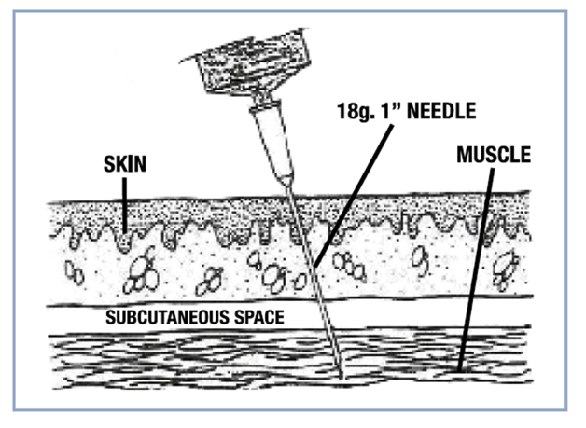
Chapter 2
Page
VQA Manual
47
Administering Animal Health Care Products (AHCP)
Subcutaneous (SQ) administration is the preferred method if the AHCP is labeled for Intramuscular (IM) or SQ administration.
Notes:
Administering Animal Health Care Products
There are several methods by which medications can be administered. (Appendix D) Subcutaneous (SQ) administration is the preferred method if the AHCP is labeled for Intramuscular (IM) or SQ administration. Injections should be limited to 5 cc per IM injection site. No more than 10 cc of the AHCP should be deposited in one site if SQ administration is used.

Slide 27
Chapter 2
Page
VQA Manual
12
Definitions of Prescriptions, Extra Label and Veterinary Feed Directive Medications
Extra Label: As its name implies, “Extra Label” means a veterinarian has advised using a medication in a way not specified on the label or package insert.
Prescription Drugs: Drugs that are labeled with the statement “Federal law restricts this drug to use by or on the order of a licensed veterinarian.”
Veterinary Feed Directive (VFD) Medications – A VFD drug is intended for use in animal feeds, permitted only by a veterinarian.
Notes:
Let’s review these definitions of prescriptions, Extra Label and Veterinary Feed Directive Medications.
Prescription Drugs: Drugs that are labeled with the statement “Federal law restricts this drug to use by or on the order of a licensed veterinarian” must be prescribed and used within the context of a valid VCPR. This includes injectable and water-soluble antimicrobials.
Extra Label: As its name implies, “Extra Label” means a veterinarian has advised using a medication in a way not specified on the label or package insert. The extra-label use of AHCPs is allowed under the Animal Medicinal Drug Use Clarification Act of 1994. Under AMDUCA, the FDA recognized the professional judgment of veterinarians, but in order to be prescribed in an extra label manner, a valid VCPR must exist. When veterinarians authorize giving a higher dose of drug than is listed on the label or package insert, using a drug to treat a disease not listed on the label or package insert, or treating another type of animal (e.g., veal calf as opposed to a heifer calf replacement), they are prescribing drugs in an “extra-label” manner.
Only a veterinarian may use or advise using a drug in an “extra-label” manner, and then only with strict limitations. It is illegal for a veal farmer, as a layman to use medications in a manner not specified or allowed on the label, unless instructed by a veterinarian with whom the farmer has a valid VCPR. Failure to comply with this policy could result in prosecution under the federal Food, Drug and Cosmetic Act. Note that label information can be obtained for most AHCPs electronically.
Veterinary Feed Directive (VFD) Medications – A VFD drug is intended for use in animal feeds, and such use of the VFD drug is permitted only under the professional supervision of a licensed veterinarian. Fluid milk and milk replacer is considered a feed, thus requires a VFD from your veterinarian. A VFD drug may not be used in an extra-label manner. A written VFD from your veterinarian is only good for a 6-month duration.

Slide 28
Chapter 2
Page
VQA Manual
13
FDA Oversight
Compared to other livestock species, a limited number of AHCPs are approved for use in veal calves.
Avoid any products with the statement “not for use in calves to be processed for veal.”
Hormone implants are strictly prohibited for use in veal calves.
Notes:
FDA Oversight:
All animal medicines are required to meet stringent FDA standards, including significant human and food safety benchmarks, prior to approval. Compared to other livestock species, a limited number of AHCPs are approved for use in veal calves. Work with your veterinarian to determine which drugs are allowed for use in veal calves.
Dairy farmers should note that when anticipating selling male bull calves to a veal farm or if selling calves to be harvested as bob veal, many medications approved for use in dairy calves are prohibited for use in veal calves and will quickly cause violative residues when administered to veal calves. Avoid any products with the statement “not for use in calves to be processed for veal”.
Hormone implants are strictly prohibited for use in veal calves.
Producers should work with the veterinarian with whom they have a valid VCPR for drug residue information first. The veterinarian is the ideal resource to discuss FARAD-specific information regarding withdrawal times, especially for extra-label drug use.

Slide 29
Chapter 2
Page
VQA Manual
11
Best Management Practices
A withdrawal table, provided by the veterinarian, is clearly displayed and is used along with the labeled information on the product container to determine withdrawal times. Monitor withdrawal times and dates carefully and document them in records.
Notes:
It is a Best Management Practice to have a withdrawal table, provided by the veterinarian, clearly displayed and used along with the labeled information on the product container to determine withdrawal times. Monitor withdrawal times and dates carefully and document them in records.

Slide 30
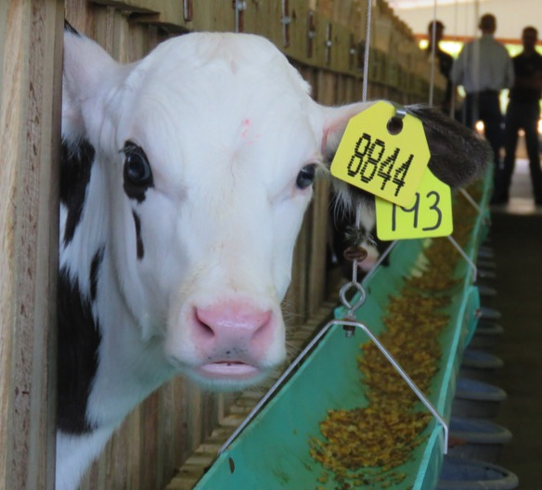
Chapter 2
Page
VQA Manual
11
Best Management Practices
All animals are identified by ear tags. The identity of animals is necessary for properly recording the treatment of individual animals in a record system.
Notes:
All animals are identified by ear tags. The identity of animals is necessary for properly recording the treatment of individual animals in a record system.

Slide 31
Chapter 2
Page
VQA Manual
15
Record Systems
Documentation of the herd health records is required by FDA for two years after marketing a group of calves.
Keeping accurate records is required by law.
Record Keeping Forms
Animal Health Product Inventory (Form 1)
Individual Animal and Group Treatment Record (Form 2)
Daily Animal or Group Treatment Record (Form 3)
Individual Calf Treatment Record (Form 4)
17
18
19
20
Notes:
Record Systems
Keeping proper and timely records is vital to any animal health program and achieves several goals:
Assures documentation of proper use of all medication, vaccinations and animal health products at the farm
Indicates when it is necessary to reorder commonly used products
Helps determine whether products have been misused or taken from the farm
Identifies effective treatments for future herds by establishing records of what treatments were effective for specific concerns
Documentation of the herd health records, which is required by FDA for two years after marketing a group of calves. Keeping accurate records is required by law.
Record Keeping Forms – page numbers for these forms in the manual are highlighted by the circle. These forms are provided as a resource.
Animal Health Product Inventory (Form 1): This form is designed to help you keep track of all product purchases, including date purchased, the amount received, lot numbers, and the company from which these products were purchased. Receipts, packing slips, and other information about each shipment of AHCPs are retained for at least two-years after calves are marketed.
Individual Animal and Group Treatment Record (Form 2): This form helps you keep records of the medication or AHCP given to each calf. These records are saved in a file for at least two years after each group of calves has been marketed.
Daily Animal or Group Treatment Record (Form 3): This is a convenient barn record that can be carried each time you check/treat calves. These records can be transferred to a more permanent file such as Form Number 2 discussed above.
Individual Calf Treatment Record (Form 4): Sometimes it is more convenient to have an individual calf treatment record for each calf in the room, perhaps fastened to the stall or pen in a plastic cover. This information can be transferred to a more permanent record such as Form Number 2 above.

Slide 32
Chapter 2
Page
VQA Manual
11
Best Management Practices
Medications and other animal health care products (AHCPs) should be obtained from a reputable supplier, properly stored and disposed of according to label directions.
Notes:
Medications and other animal health care products (AHCPs) should be obtained from a reputable supplier, properly stored and disposed of according to label directions.
It is also essential to follow label instructions for storing and administering AHCP. For example, a label may state that the entire bottle should be used within a certain time period and then be discarded. Those instructions are important for maintaining the safety and effectiveness of the product.

Slide 33
Chapter 2
Page
VQA Manual
14
Storage of Animal Health Care Products
Store AHCPs according to label instructions
Remaining medications should be stored in a refrigerator at constant temperature of 35-45°F
A thermometer is kept in the refrigerator
Sanitize the tops of bottles that have been opened
Syringes to be used for modified live virus vaccines (MLV) should be thoroughly rinsed
Store AHCPs in a refrigerator, special cabinet, separate room or other protected area that can be locked
Notes:
You can find more guidance in the manual regarding AHCP storage:
Store AHCPs according to label instructions; most medications from which some product has been used should be stored in a refrigerator at constant temperature of 35-45°F. Coolers are not an appropriate form of permanent storage.
Antiseptics, wound dressings, vitamin or mineral products, and other products that do not require refrigeration can be stored in cabinets. Store in cool, dry conditions. Re-seal containers as much as possible between uses.
A thermometer is kept in the refrigerator to determine if the temperature is accurate; discard any vaccines, medications or other AHCPs that become frozen.
Sanitize the tops of bottles that have been opened, and from which some product has been withdrawn (e.g., with alcohol), before storing and just prior to reuse.
Store AHCPs in a refrigerator, special cabinet, separate room or other protected area that can be locked.

Slide 34
Chapter 2
Page
VQA Manual
14
Storage of Animal Health Care Products
Use a new or sanitized needle for each animal
Keep syringes, needles and other administration supplies in their individual wrappers until use
Syringes to be used for modified live virus vaccines (MLV) should be thoroughly rinsed with sterile water or saline after disinfecting to remove any disinfectant residue; disposable needles and syringes are preferred.
Never leave needles or syringes in the AHCP container between uses.
Do not mix different AHCP in syringes
Notes:
AHCP Storage and Disposal Recommended Guidelines
Use a new or sanitized needle for each animal injection to minimize disease transmission and contamination.
Keep syringes, needles and other administration supplies in their individual wrappers until use, then thoroughly clean, sanitize, and store in airtight plastic containers, or discard.
Syringes to be used for modified live virus vaccines (MLV) should be thoroughly rinsed with sterile water or saline after disinfecting to remove any disinfectant residue; disposable needles and syringes are preferred.
Never leave needles or syringes in the AHCP container between uses.
Do not mix different AHCP in syringes

Slide 35
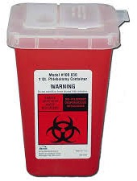
Chapter 2
Page
VQA Manual
15
Disposal Do’s and Don’ts
DO immediately place used needles and other sharps in a sharps disposal container
DO use an FDA-cleared sharps disposal container
DO keep all sharps and sharps disposal containers out of reach of children and pets
DO ask the manufacturer of your drug products if they can provide a sharps disposal container
Notes:
Disposal:
DO immediately place used needles and other sharps in a sharps disposal container to reduce the risk of needle sticks, cuts or punctures from loose sharps.
DO use an FDA-cleared sharps disposal container, if possible. If an FDA-cleared container is not available, consult your veterinarian regarding appropriate disposal containers and methods including: where and how to get an FDA-cleared sharps disposal container, if they can dispose of your used needles and other sharps, or if they know of sharps disposal programs near you.
DO keep all sharps and sharps disposal containers out of reach of children and pets.
DO ask the manufacturer of your drug products that are used with a needle or other sharps if they provide a sharps disposal container to clients at no charge.

Slide 36
Chapter 2
Page
VQA Manual
15
Disposal Do’s and Don’ts
DON’T throw loose needles and other sharps into the trash.
DON’T flush needles and other sharps down the toilet.
DON’T put needles and other sharps in your recycling bin -- they are not recyclable.
DON’T try to remove, bend, break, or recap needles used by another person.
DON’T attempt to remove the needle without a needle clipper because the needle could fall, fly off, or get lost and injure someone.
Notes:
Disposal:
DON’T throw loose needles and other sharps into the trash.
DON’T flush needles and other sharps down the toilet.
DON’T put needles and other sharps in your recycling bin -- they are not recyclable.
DON’T try to remove, bend, break, or recap needles used by another person. This can lead to accidental needle sticks, which may cause serious infections.
DON’T attempt to remove the needle without a needle clipper because the needle could fall, fly off, or get lost and injure someone.
Return outdated drugs to the supplier. Empty bottles of medicine – biological or pharmaceuticals – must be disposed in a landfill and cannot be recycled.

Slide 37
Chapter 2
Page
VQA Manual
11
Best Management Practices
A few pens in a designated area of the barn should be used to place sick or injured calves
All calves are checked carefully at least twice daily, and preferably three or more times each day
Notes:
Best Management Practice
A few pens in a designated area of the barn should be used to place sick or injured calves; ideally, these calves should be placed in an isolation area separate from the main calf housing room(s).
All calves are checked carefully at least twice daily, and preferably three or more times each day. Any necessary health-care action is taken immediately, either by contacting the veterinarian or by administering the treatment prescribed by the veterinarian for other calves in the same group with similar symptoms.

Slide 38
Chapter 2
Page
VQA Manual
11
Best Management Practices
The veterinarian, or a diagnostic laboratory, conducts tests on feces, urine, blood, or other appropriate tissues from sick animals in order to identify:
(A) the organisms or diseases that have caused the sickness, and
(B) medications that are most effective in treating the sickness.
Notes:
Best Management Practice
The veterinarian, or a diagnostic laboratory, conducts tests on feces, urine, blood, or other appropriate tissues from sick animals in order to identify: (A) the organisms or diseases that have caused the sickness, and (B) medications that are most effective in treating the sickness.

Slide 39
Chapter 2
Page
VQA Manual
11
Best Management Practices
In consultation with a veterinarian, veal farmers should establish on-farm protocols for monitoring and determining when euthanasia is the best option for sick or injured calves.
Notes:
Best Management Practice
Providing quality care is the priority of veal farmers, but occasionally, when calves cannot recover from illness or injury, euthanasia is the most humane option. In consultation with their veterinarian, veal farmers should establish on-farm protocols for monitoring and determining when euthanasia is the best option for sick or injured calves.

Slide 40
Chapter 2
Page
VQA Manual
14
Euthanasia Guidelines
Consult with your veterinarian to determine the options and guidelines for euthanizing animals in accordance with practices outlined by the American Vet Medical Association (AVMA) and state law.
Veterinarian routinely conducts an extensive post-mortem evaluation (with pathogen identification) to determine the cause of sickness or death and to monitor the efficiency of treatments.
Notes:
Euthanasia Guidelines
Veal farmers consult with their veterinarian to determine the options and guidelines for euthanizing such animals in accordance with practices outlined by the American Vet Medical Association (AVMA) and state law.
The veterinarian routinely conducts an extensive post-mortem evaluation (with pathogen identification) to determine the cause of sickness or death and to monitor the efficiency of treatments.
Carcass disposal is conducted in accordance with state laws and guidelines.

Slide 41
Chapter 2
Page
VQA Manual
21
Guidelines for Immunizations
The timing of vaccines is important. In most cases, calves respond best to viral vaccines if given a few days to one week after the calf arrives at the farm.
Notes:
Collaborating with your veterinarian and other specialists to create an immunization program plays an important role in keeping calves healthy. The VQA manual provides guidelines for immunizations. You can find that background beginning on page 21. The information provided in the manual does not replace the advice of a veterinarian and is intended to provide a better understanding of the benefits and shortcomings of vaccination programs.
The timing of vaccines is important. In most cases, calves respond best to viral vaccines if given a few days to one week after the calf arrives at the farm. Because of stress and other factors, animals do not respond as well to vaccines upon arrival at the farm. The viral vaccine is repeated two to three weeks later.

Slide 42
WHAT QUESTIONS DO YOU HAVE?
Best Management Practices
VCPR
Administering AHCP
Store of AHCP
Euthanasia
Record Keeping
Immunizations
UP NEXT: Chapter 3 Feed, Water & Nutrition
Notes:
Before me move ahead to Chapter 3, what questions do you have?

Slide 43
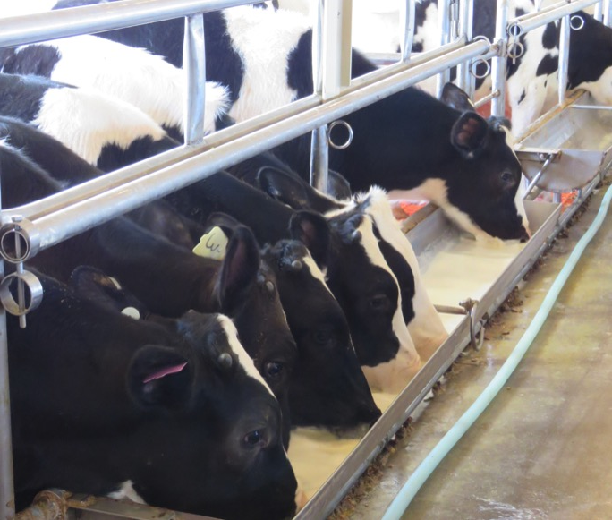
Chapter 3
Page
VQA Manual
24
Veal calves should be provided adequate nutrition and water through every state of life to promote growth and development, disease abatement and thermoregulation.
Notes:
Veal calves should be provided adequate nutrition and water through every state of life to promote growth and development, disease abatement and thermoregulation. Although dairy products and by-products, particularly whey protein concentrate, still form the basis for most veal feeds, there are alternative nutrient sources that give satisfactory results when the ingredients are combined correctly and thoroughly tested through research and development. Veal farmers should work with reputable experts (animal nutritionist, veterinarians, feed company representative, etc.) to design a nutritional program for veal calves. As a reminder, higher milk intakes will result in looser feces but this is not always associated with increased diarrhea or other health problems.

Slide 44
Chapter 3
Page
VQA Manual
25
Best Management Practices
Work with a reputable nutrition expert to provide quality feed that meets the nutritional requirements of veal calves and contains the nutrition necessary to maintain health, growth and energy.
Veal calves provided grain should be fed a high-quality starter that promotes rumen development.
Notes:
Here are the Best Management Practices for Feed, Water and Nutrition
Work with a reputable nutrition expert to provide quality feed that meets the nutritional requirements of veal calves and contains the nutrition necessary to maintain health, growth and energy.
Veal calves provided grain should be fed a high-quality starter that promotes rumen development.

Slide 45
Chapter 3
Page
VQA Manual
25
Best Management Practices
Feed should have proper protein and fat levels for the age and size of the calf.
Feed mixing and distribution equipment should be designed to facilitate easy, thorough cleaning and sanitizing.
Buckets, bottles and all equipment used for mixing or distributing feeds should be completely cleaned and sanitized daily between uses.
Notes:
Here are the Best Management Practices for Feed, Water and Nutrition
Feed should have proper protein and fat levels for the age and size of the calf.
Feed mixing and distribution equipment should be designed to facilitate easy, thorough cleaning and sanitizing.
Buckets, bottles and all equipment used for mixing or distributing feeds should be completely cleaned and sanitized daily between uses.

Slide 46
Chapter 3
Page
VQA Manual
25
Best Management Practices
Maximize water intake immediately upon arrival of the calves.
All calves should have access to clean, fresh water to maintain proper hydration from the first day of life.
Every barn should have access to an adequate and reliable hot water supply necessary for appropriate feed-mixing and equipment sanitation.
Notes:
Here are the Best Management Practices for Feed, Water and Nutrition
Maximize water intake immediately upon arrival of the calves.
All calves should have access to clean, fresh water to maintain proper hydration from the first day of life.
Every barn should have access to an adequate and reliable hot water supply necessary for appropriate feed-mixing and equipment sanitation.

Slide 47
Chapter 3
Page
VQA Manual
25
Best Management Practices
Animal caretakers are trained in calf care, nutritional requirements and feeding techniques, including the use of esophageal tube feeders and other feeding mechanisms.
Maintain close communication with your feed representative and keep the representative informed about the progress and any health complications of the calves.
Notes:
Here are the Best Management Practices for Feed, Water and Nutrition
Animal caretakers are trained in calf care, nutritional requirements and feeding techniques, including the use of esophageal tube feeders and other feeding mechanisms.
Maintain close communication with your feed representative and keep the representative informed about the progress and any health complications of the calves.

Slide 48
Chapter 3
Page
VQA Manual
27
Additional Feed and Nutrition Guidelines
Follow your advisors’ recommendations for using electrolytes.
Provide water between feedings to the calves.
Carefully follow the feed manufacturer’s recommendations on water temperature for mixing the milk replacer with water.
Provide sufficient space for group-fed calves that allows all animals to feed at the same time or sufficient quantities of feed are available for all animals during a 24-hour period.
Notes:
Additional feed and nutrition guidelines include:
Make sure your feed service representative and your veterinarian are familiar with each other and communicate about the health and nutrition of your calves. Follow your advisors’ recommendations for using electrolytes. Provide water between feedings to the calves.
Carefully follow the feed manufacturer’s recommendations on water temperature for mixing the milk replacer with water.
Provide sufficient space for group-fed calves that allows all animals to feed at the same time or sufficient quantities of feed are available for all animals during a 24-hour period.

Slide 49
Chapter 3
Page
VQA Manual
27
Additional Feed and Nutrition Guidelines
When the feed is changed, such as from a starter to a grower or finisher, the blending of the different types of feeds takes place over a 6- to 10 day period.
Nutritional amendments such as iron, selenium or vitamins are provided orally, if needed, and are based upon blood analyses and examination/recommendations by your feed service representative in consultation with your veterinarian.
Notes:
Additional feed and nutrition guidelines include:
When the feed is changed, such as from a starter to a grower or finisher, the blending of the different types of feeds takes place over a 6- to 10 day period.
Nutritional amendments such as iron, selenium or vitamins are provided orally, if needed, and are based upon blood analyses and examination/recommendations by your feed service representative in consultation with your veterinarian.

Slide 50
Chapter 3
Page
VQA Manual
27
Additional Feed and Nutrition Guidelines
Meat and bone meals are prohibited, whereas milk and blood products can be fed. Check the ingredient list of products and contact the manufacturer if there is a question.
Feeding and watering equipment must be in good repair, functional and free of sharp edges that may injure animals.
Animal caretakers take care to use the appropriate weight of powder, and volume and temperature of water to ensure consistency when mixing milk replacers.
Notes:
Additional feed and nutrition guidelines include:
The FDA has prohibited the feeding of most ruminant-derived protein to cattle or other ruminants because bovine spongiform encephalopathy (BSE) may be spread by feeding such products. Meat and bone meals are prohibited, whereas milk and blood products can be fed. Check the ingredient list of products and contact the manufacturer if there is a question.
Feeding and watering equipment must be in good repair, functional and free of sharp edges that may injure animals.
Animal caretakers take care to use the appropriate weight of powder, and volume and temperature of water to ensure consistency when mixing milk replacers, and use clean feeders and sanitary practices.

Slide 51
Chapter 3
Page
VQA Manual
27
Additional Feed and Nutrition Guidelines
During heat stress, increase the amount of liquid consumption. Milk may also be fed at a cooler temperature (depending on manufacturer’s recommendations) and water intake increased.
Water is tested and monitored by your nutritionist, veterinarian, or feed service representative at least once each year.
Notes:
Additional feed and nutrition guidelines include:
During heat stress, increase the amount of liquid consumption. Milk may also be fed at a cooler temperature (depending on manufacturer’s recommendations) and water intake increased.
Water is tested and monitored by your nutritionist, veterinarian, or feed service representative at least once each year.

Slide 52
WHAT QUESTIONS DO YOU HAVE?
Best Management Practices
Nutrition
Feed
Water
UP NEXT: Chapter 4 Housing & Facilities
Notes:
Are there any questions regarding nutrition, feed and water?

Slide 53
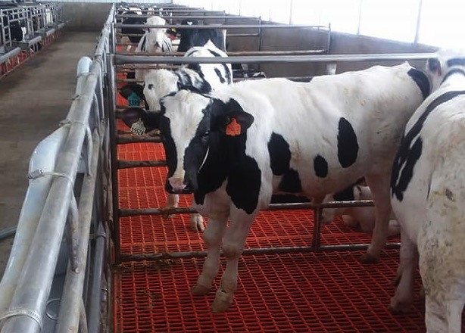
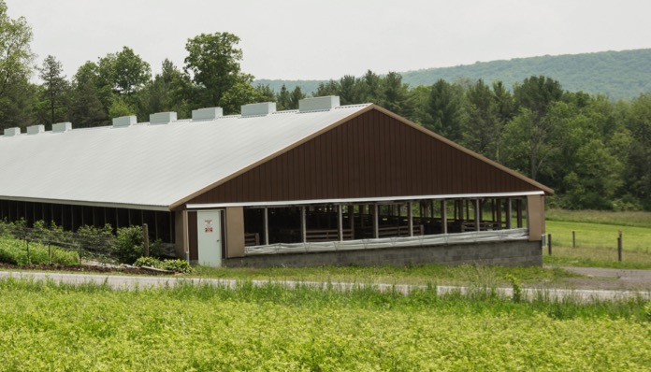
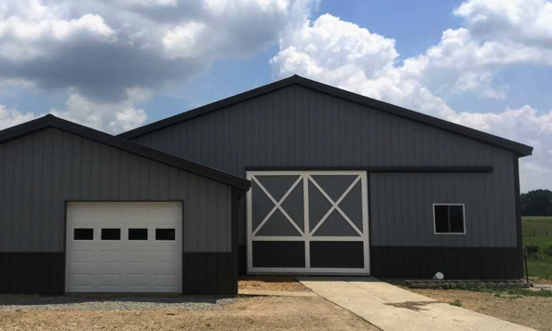
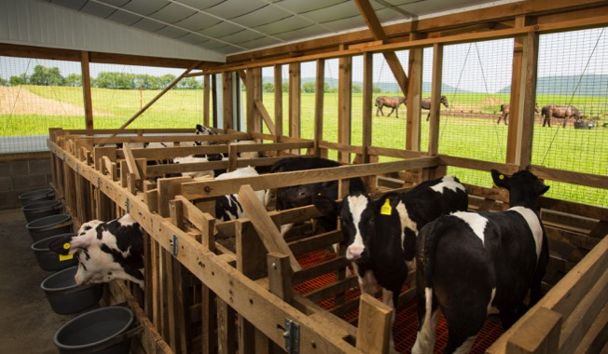
Chapter 4
Page
VQA Manual
28
Notes:
The milk-fed veal industry has seen significant changes in housing and facilities, most noticeably is the move to raise calves in group pens.
Group housed calves must be strategically grouped to ensure they are housed with calves that have a similar size, age, and drinking habits. Calves must always have access to clean, fresh water. Veal farmers should adopt a protocol for individual monitoring that ensures maximum health and comfort for each animal. Consult with your veterinarian to develop a robust herd-health program specifically designed for group-housed calves.

Slide 54
Chapter 4
Page
VQA Manual
29
Best Management Practices
Adequate space is provided for calves to easily stand, stretch, lie down, turn around, groom naturally, and have visual contact with other calves.
Calves are in group pens of two or more calves, and no calf is individually penned after 10 weeks of age, unless it is for health purposes such as sickness, injury or disease.
Calves should never be tethered.
Notes:
Here are the Best Management Practices related to housing and facilitates:
Adequate space is provided for calves to easily stand, stretch, lie down, turn around, groom naturally, and have visual contact with other calves.
Calves are in group pens of two or more calves, and no calf is individually penned after 10 weeks of age, unless it is for health purposes such as sickness, injury or disease.
Calves should never be tethered.

Slide 55
Chapter 4
Page
VQA Manual
29
Best Management Practices
Facilities are ventilated, and protocols are in place to minimize airborne particles as a means to reduce odors, dust and/or noxious gases.
All classes of calves are provided with reasonable protection from heat and cold.
Facilities provide ample natural and/or overhead lighting.
Notes:
Here are the Best Management Practices related to housing and facilitites:
Facilities are ventilated, and protocols are in place to minimize airborne particles as a means to reduce odors, dust and/or noxious gases. Properly ventilated barns maximize animal health and comfort and provide a safer work environment for employees and calf caretakers.
All classes of calves are provided with reasonable protection from heat and cold.
Facilities provide ample natural and/or overhead lighting.

Slide 56
Chapter 4
Page
VQA Manual
29
Best Management Practices
Pens are routinely cleaned, and the resting area provides cushion, warmth, dryness and traction at all times.
All housing elements including flooring, fans, waterers, gates and fences are consistently monitored and in good repair.
A plan is in place for managing and eliminating pests.
A visitor protocol is established and employees are trained at following visitor procedures.
Notes:
Here are the Best Management Practices related to housing and facilitites:
Pens are routinely cleaned, and the resting area provides cushion, warmth, dryness and traction at all times.
All housing elements including flooring, fans, waterers, gates and fences are consistently monitored and in good repair.
A plan is in place for managing and eliminating pests, especially those that carry disease or contamination.
A visitor protocol is established and employees are trained at following visitor procedures. Best practices include limiting the number of visitors at the barn or farm, limit the areas on the farm where visitors may go, and provide disposable plastic boots (and possibly coveralls) or footbaths to visitors who enter the calf housing areas.

Slide 57
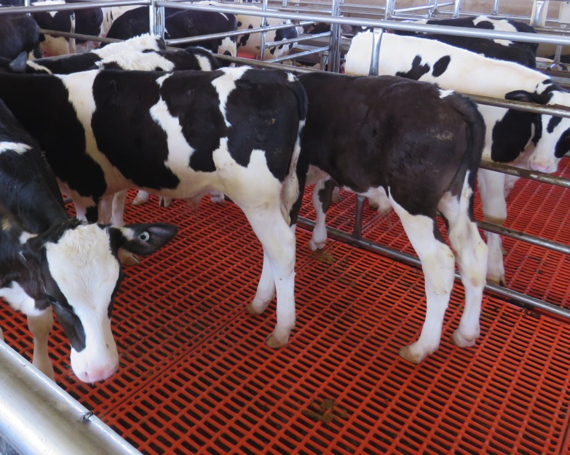
Chapter 4
Page
VQA Manual
30
Additional Guidelines
Sanitary and dry place to rest
Ensure good hoof and joint health
Monitor and take action to reduce the risk of slips and falls
Concrete flooring is acceptable when grooved or textured
If lameness becomes an issue, corrective action needs to be taken
Notes:
Calves should be provided a dry, sanitary place to rest. There are many floor types on the market that will ensure these goals and other goals are met are met, including ensuring good hoof and joint health. Veal farmers should monitor and take action to reduce the risk of slips and falls. Under best practices, concrete flooring surfaces are acceptable when appropriately grooved or textured to reduce the risk of animals slipping, which can result in injuries, and should be designed to avoid injury. Skid-resistant surfaces must reduce injuries and retain their non-slip characteristic after cleaning, scraping or wear. High-traction, rubber flooring is desirable in pens. Calves should be monitored for potential leg injuries and lameness, and if routine issues occur, corrective action addressing the issue should be taken.

Slide 58
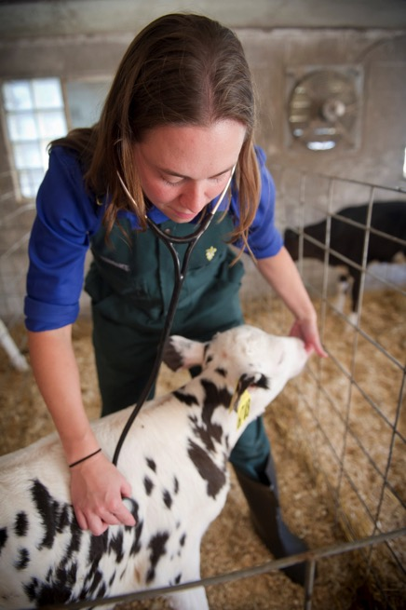
Chapter 4
Page
VQA Manual
30
Area for sick or injured animals
Employ a sick pen that isolates the animal(s) from others until they have regained their health.
It should provide adequate bedding, air movement and easy access to feed and water.
Notes:
Area for sick or injured animals
Employ a sick pen that isolates the animal(s) from others until they have regained their health. Because sick or injured animals are more susceptible to discomfort than healthy animals, it is important that the pen be equipped to maximize animal comfort. It should provide adequate bedding, air movement and easy access to feed and water.

Slide 59
Chapter 4
Page
VQA Manual
31
Ventilation and Heating
A healthy environment promotes healthy calves. Veal farmers should ensure that barns are properly ventilated to maximize animal health and comfort. In addition, well-ventilated barns provide a safer work environment for employees and calf caretakers.
Notes:
The information reviewed in this section should not be substituted for consultation with a veal/livestock housing (ventilation and heating) expert as well as meeting necessary local building code requirements.
Ventilation and Heating
A healthy environment promotes healthy calves. Veal farmers should ensure that barns are properly ventilated to maximize animal health and comfort. In addition, well-ventilated barns provide a safer work environment for employees and calf caretakers.
Consult with experts to determine the best system for the farm to create the best environment that provides optimum employee comforts and calf health.
Insulation, ventilation, and heating must all work together to achieve an optimum environment. Adjustments can usually be made for individual situations which are best determined by an expert in the field.

Slide 60
Chapter 4
Page
VQA Manual
32
Monitor Temperature and Humidity Daily
Optimum temperatures are: 65-70° F for starting calves and 60° F for market age calves.
Maintain humidity levels required for healthy calves. The optimum relative humidity for veal calves is 50% to 65%. There is increased condensation and more transport of airborne bacteria at humidity levels higher than 65%.
Install thermometers in several places in the calf barn to track temperature.
Notes:
Monitor temperature and humidity in your calf barn daily. You or your veal housing experts should regularly evaluate conditions within your calf barn by using instruments specifically designed to measure environmental factors. It generally takes a minimum of 24 hours to see changes in air quality after a change in ventilation is made.
There should be adequate supplemental heat to maintain desired temperatures and allow minimum ventilation rates to remove moisture and gases. The heater should be able to maintain the temperature when the minimum ventilation fan is running and the building is full of small animals. Optimum temperatures are: 65-70° F for starting calves and 60° F for market age calves. There should be little temperature fluctuation within the building when the weather is cool (less than 5°F for calves less than 200 lbs. and less than 10°F for larger calves).
Maintain humidity levels required for healthy calves. The optimum relative humidity for veal calves is 50% to 65%. There is increased condensation and more transport of airborne bacteria at humidity levels higher than 65%. At lower levels, there is increased dustiness and during cold weather, the building will require more heat. Dust levels should not exceed 2.5 milligrams per cubic meter of air. It should be noted that calves are a major source of humidity, releasing approximately 0.22 lbs. of moisture/100 lbs. body weight/hour into the air.
Install thermometers in several places in the calf barn (at least one maximum/minimum thermometer and a portable thermometer) to allow you to track temperature changes and variations throughout the barn.

Slide 61
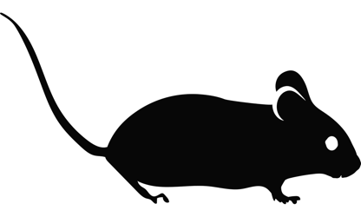
Chapter 4
Page
VQA Manual
33
Pest Control
Every farm should have a plan for managing and eliminating pests, especially those that carry disease or contamination
Control flies, mosquitoes, lice, mites, ticks, grubs, fleas, rodents, skunks and pest birds.
exercise caution to avoid contaminating feedstuffs, as contaminants may pass into the human food chain via veal.
Notes:
Every farm should have a plan for managing and eliminating pests, especially those that carry disease or contamination. Best practices should focus on procedures to control flies, mosquitoes, lice, mites, ticks, grubs, fleas, rodents, skunks and pest birds (e.g., starlings, pigeons and sparrows). Specifically, exercise caution to avoid contaminating feedstuffs, as contaminants may pass into the human food chain via veal. A certified pesticide applicator or a pesticide service may be used. Read and follow label directions for all pesticide products. Cats and dogs kept at the farm must be vaccinated for rabies. In some regions, wildlife can also spread rabies so it is important to know if this is a concern in your region.

Slide 62
Chapter 4
Page
VQA Manual
33
Barn Sanitation Guidelines
All parts of the barn, including the feed storage and mixing areas, and distribution hoses should be cleaned, sanitized, and dried to reduce the possibility of microbial growth.
Allow sufficient time between groups of calves for proper cleaning, sanitizing and drying of the barn and pens.
Make any repairs or changes pens, facilities, gates, and unloading docks.
Notes:
Barn Sanitation
All parts of the barn, including the feed storage and mixing areas, and distribution hoses should be cleaned, sanitized, and dried to reduce the possibility of microbial growth.
Allow sufficient time between groups of calves for proper cleaning, sanitizing and drying of the barn and pens. The time allotted also allows for repairs to pens and other parts of the facility.
Water spraying or dripping equipment is available to thoroughly soak the pens, stall floors and areas beneath the pens immediately after the calves leave the barn for market.
High pressure or steam cleaning and/or scraping of all surface areas are thorough and include cleaning the bottoms of the stall floors when necessary.
Thoroughly clean and sanitize the ceilings, side walls, ventilation tubes, loading/unloading docks and chutes, as well as all other areas in the calf housing area. Use the sanitizing solution according to label directions.
Make any repairs or changes to the unloading docks or gates that will allow easier, safer and less stressful unloading and penning of calves.

Slide 63
Chapter 4
Page
VQA Manual
33
Visitors in your Facilities
Establish a visitor protocol and ensure that employees are trained at following visitor procedures.
Best practices include limiting the number of visitors at the barn or farm, limit the areas on the farm where visitors may go, and provide disposable plastic boots or footbaths to visitors who enter the calf housing areas.
Notes:
Visitors in your Facilities
Ensure that visitors do not introduce contamination or disease to the farm or barns. Establish a visitor protocol and ensure that employees are trained at following visitor procedures. Best practices include limiting the number of visitors at the barn or farm, limit the areas on the farm where visitors may go, and provide disposable plastic boots (and possibly coveralls) or footbaths to visitors who enter the calf housing areas. Footbaths are also recommended between calf rooms within the same barn, especially when different rooms house calves of different ages, or there is a disease outbreak in one of the rooms. In addition, ensure that visitors are advised of safety concerns at all areas of barns and farms.

Slide 64
WHAT QUESTIONS DO YOU HAVE?
Housing
Ventilation
Pest Control
Barn Sanitation
Visitors
UP NEXT: Chapter 5 Handling & Transportation
Notes:
What questions can I answer regarding housing and facilities?

Slide 65
Chapter 5
Page
VQA Manual
35
Best Management Practices
Calves are to be moved to their destination by walking them or lifting them safely and efficiently.
Transportation plans are developed, documented and implemented to eliminate thermal distress, dehydration, interruptions in routine feeding, physical exertion, exposure to pathogens and stress from weather changes.
Notes:
Best Management Practices Checklist
Calves are to be moved to their destination by walking them or lifting them safely and efficiently (for short-distances with handler arms gently supporting the animal from under the neck and under the loin or around the rump.)
Transportation plans are developed, documented and implemented to eliminate thermal distress, dehydration, interruptions in routine feeding, physical exertion, exposure to pathogens and stress from weather changes.

Slide 66
Chapter 5
Page
VQA Manual
35
Best Management Practices
An efficient number of helpers are scheduled to safely perform any task related to handling and transportation.
Calves are always handled in a quiet, calm, consistent, non-threatening and gentle manner.
Notes:
Best Management Practices Checklist
An efficient number of helpers are scheduled to safely perform any task related to handling and transportation.
Calves are always handled in a quiet, calm, consistent, non-threatening and gentle manner.

Slide 67
Chapter 5
Page
VQA Manual
35
Best Management Practices
The movement of calves when sorting or moving them from any pen is completed with safety and efficiency in mind. Calves are never dragged, pulled, thrown or caught by the neck, ears, limbs, tail or other extremities.
Caretakers are properly trained in safe and efficient animal handling. The consequence for startling, painful or rough handling of all animals is known and enforced.
Notes:
Best Management Practices Checklist
The movement of calves when sorting or moving them from any pen is completed with safety and efficiency in mind. Calves are never dragged, pulled, thrown or caught by the neck, ears, limbs, tail or other extremities.
Caretakers are properly trained in safe and efficient animal handling. The consequence for startling, painful or rough handling of all animals is known and enforced.

Slide 68
Chapter 5
Page
VQA Manual
36
Livestock Handling Guidelines
Producers should always ensure that the least amount of prodding is used to move the animal. The use of flags, plastic paddles and a stick with ribbon attached to it are appropriate for stimulating animals to move, slow, stop or turn. However, no equipment should be used as a weapon. Any force used on animals must be applied quietly, calmly, and with sound logic that provides for a productive, safe outcome.
Notes:
Some recommended livestock handling guidelines include:
Producers should always ensure that the least amount of prodding is used to move the animal while ensuring the safety of all employees and other calves. All handlers should understand that cattle are observant creatures capable of learning from and remembering events in their environment.
The use of flags, plastic paddles and a stick with ribbon attached to it are appropriate for stimulating animals to move, slow, stop or turn. However, no equipment should be used as a weapon. Any force used on animals must be applied quietly, calmly, and with sound logic that provides for a productive, safe outcome. Excessive or routine prodding can indicate underlying handling and animal avoidance problems that require management attention and correction. Conflict behavior in animals are direct indications of inefficient handling of subject animals.

Slide 69
Chapter 5
Page
VQA Manual
36
Livestock Handling Guidelines
2. Conflict behavior in animals are direct indications of inefficient handling of subject animals. Handling problems could arise because:
caretakers may be inadequately trained in safe animal handling
facility may be designed inefficiently
animal may be injured, ill, or expressing unsafe avoidance or conflict behaviors
Notes:
Excessive or routine prodding can indicate underlying handling and animal avoidance problems that require management attention and correction. Conflict behavior in animals are direct indications of inefficient handling of subject animals.
Handling problems could arise because:
the caretakers may be inadequately trained in safe animal handling,
the facility may be designed inefficiently,
the animal may be injured, ill, or expressing unsafe avoidance or conflict behaviors.

Slide 70
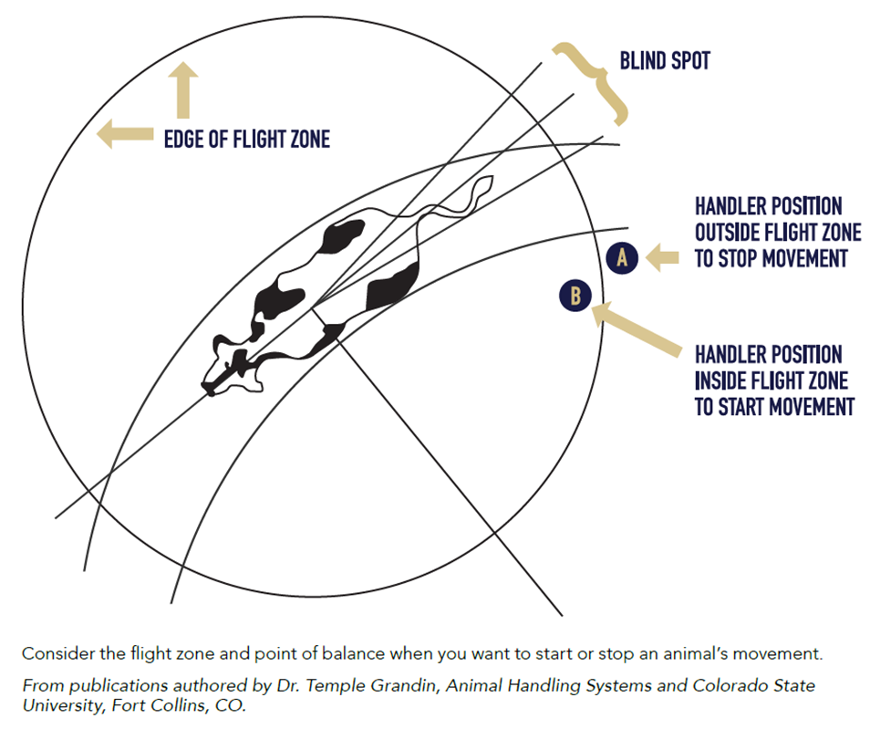
Chapter 5
Page
VQA Manual
36
Livestock Handling Guidelines
3. Cattle should be moved at a walk. It is important to control the calves’ speed within lanes, around corners, and along alleyways to prevent crowding and injury. Use full-sided panels rather than gates to move calves.
4. Consider the flight zone.
(Appendix F)
Notes:
3.Cattle should be moved at a walk, particularly if the weather is extreme, for example, the temperature is excessively hot or cold, or humidity has caused slippery flooring. It is particularly important to control the calves’ speed within lanes, around corners, and along alleyways to prevent crowding and injury around handlers, corners, gates, and places where passages narrow. Use full-sided panels rather than gates to move calves. Turns at 45˚ degree angles encourage efficient and safe calf flow. 90˚ turns should be avoided where possible. Teaching calves to walk around corners and pass handlers without an increased rate of movement is an excellent, scientific process for ensuring that animals learn to face and walk toward all destinations.
4. Consider the flight zone and point of balance when you want to either start or stop a calf’s movement. (Appendix F)

Slide 71
Chapter 5
Page
VQA Manual
36
Livestock Handling Guidelines
5. Use non-skid flooring or non-slip materials
6. The process of being moved could be unfamiliar to calves
Four procedures should be taken when moving calves:
train caretakers in safe and efficient transport loading and unloading practices
use efficiently located and designed loading areas
minimize the number of directional changes an animal encounters
train animals to face away from handlers and walk to all destinations
Notes:
5. Non-skid flooring and/or sand or other non-slip materials should be used where calves travel.
6. The process of being moved, especially if it involves an elevated-loading ramp, could be unfamiliar to calves.
Four procedures should be taken:
train caretakers in safe and efficient transport loading and unloading practices,
use efficiently located and designed loading areas,
minimize the number of directional changes an animal encounters,
train animals to face away from handlers and walk to all destinations.

Slide 72
Chapter 5
Page
VQA Manual
36
Transporting Calves
7. Veal calves are temperature sensitive. Transportation should be developed and implemented to eliminate thermal distress, dehydration, interruptions in routine feeding, physical exertion, exposure to pathogens and weather changes.
Loading areas should be accessible in all kinds of weather. Loading ramps should not exceed a 25-degree angle and should have non-slip flooring ensuring safe footing.
Notes:
Transporting Calves
7. Veal calves are temperature sensitive and require special care during transport. Weather forecast should be monitored to avoid transporting calves during inclement weather. Before loading animals, ensure that a health and behavior assessment has been done on all calves ensuring that ill or otherwise compromised calves are not loaded or transported. Transportation should be developed and implemented to eliminate thermal distress, dehydration, interruptions in routine feeding, physical exertion, exposure to pathogens and weather changes.
To keep calves healthy, take great care to minimize distress during transport. Ensure that employees and third-party transportation services are fully trained and skilled at handling and transporting calves.
Loading areas should be accessible in all kinds of weather. Loading ramps should not exceed a 25-degree angle and should have non-slip flooring ensuring safe footing. Ramps should be equipped with wing gates and a self-aligning bumper to prevent animals from stepping up or down between the ramp and the transport or being stuck between the side of the chute and transport.

Slide 73
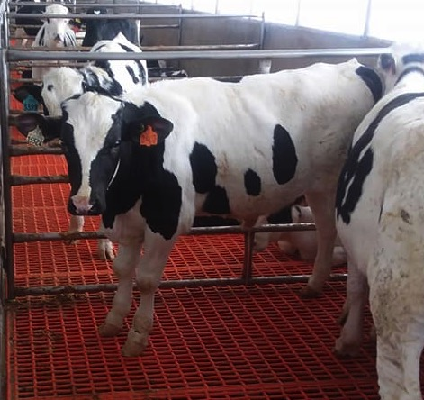
Chapter 5
Page
VQA Manual
37
Transporting Calves
To keep calves healthy, take great care to minimize distress during transport.
Veal calves are temperature sensitive and require special care during transport.
Notes:
Transporting Calves
To keep calves healthy, take great care to minimize distress during transport. Ensure that employees and third-party transportation services are fully trained and skilled at handling and transporting calves. Transportation should be developed and implemented to eliminate thermal distress, dehydration, interruptions in routine feeding, physical exertion, exposure to pathogens and weather changes.
Veal calves are temperature sensitive and require special care during transport. Weather forecast should be monitored to avoid transporting calves during inclement weather. Before loading animals, ensure that a health and behavior assessment has been done on all calves ensuring that ill or otherwise compromised calves are not loaded or transported.

Slide 74
Chapter 5
Page
VQA Manual
37
Transporting Calves Guidelines
1. Increase the well-being potential of the calf during transport by feeding a combination of electrolytes, dextrose, and water about 6 hours before calf transportation.
Avoid feeding milk just prior to moving calves.
Notes:
Transporting Calves
Some recommended guidelines include:
Increase the well-being potential of the calf during transport by feeding a combination of electrolytes, dextrose, and water about 6 hours before calf transportation. Avoid feeding milk just prior to moving calves.

Slide 75
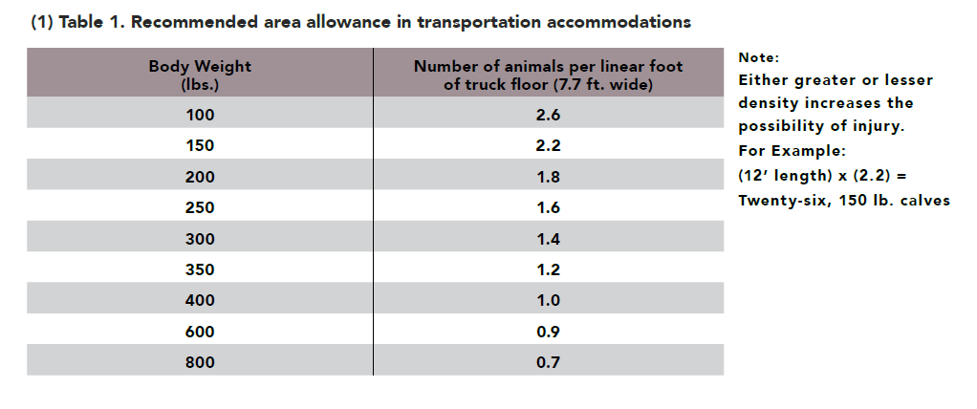
Chapter 5
Page
VQA Manual
37
2. Use Proper Loading Densities
Notes:
Transporting Calves
2) Use proper loading densities. Load and unload animals at a time of day that is best for moving calves (Table 1). During hot weather, try to transport calves at night or early morning when temperatures are lower. During extreme cold weather, try to transport during daylight or early evening when temperatures are higher. Animals grouped together for the first time should not be crowded. It is best to try to keep grouped penned calves together in the truck, where possible. Sufficient handlers and appropriate equipment should be available for loading or unloading animals from transport

Slide 76
Chapter 5
Page
VQA Manual
37
Transporting Calves
3. Even though transportation vehicles are not stationary, they require the same type of safety features as other facilities. These include:
Sides high enough to prevent animals from jumping over them,
Non-slip flooring that provides secure footing (avoid abrasive floor and wall surfaces),
Ventilation adequate for the weather conditions,
Proper bedding (to protect animals from weather extremes),
Adequate vehicle and holding pen covering to protect animals from adverse weather,
Trucks should have exhaust stacks that prevent the animals from being exposed to fumes.
Notes:
Transporting Calves
3) Trucks and trailer transport vehicles can have a direct impact on measurable animal well-being. Even though transportation vehicles are not stationary, they require the same type of safety features as other facilities. These include:
Sides high enough to prevent animals from jumping over them,
Non-slip flooring that provides secure footing (avoid abrasive floor and wall surfaces),
Ventilation adequate for the weather conditions,
Proper bedding (to protect animals from weather extremes),
Adequate vehicle and holding pen covering to protect animals from adverse weather,
Trucks should have exhaust stacks that prevent the animals from being exposed to fumes.

Slide 77
Chapter 5
Page
VQA Manual
37
Transporting Calves
Veal farmers/manager should:
4) Be familiar with the actual transport drivers. Also, managers should check the truck prior to loading to assure proper safety of the calves.
5) Develop and follow a documented disease prevent protocol
6) Specify the documented loading and unloading time with the transport driver and coordinate those times with the processing facilities
Notes:
Transporting Calves
4) Producers should be familiar with the actual transport drivers or have reviewed their references to make sure animals will be cared for properly during transit. Also, managers should check the truck prior to loading to assure proper safety of the calves and that provisions have been made for unexpected, inclement weather.
5)Producers should develop and follow a documented disease prevention protocol for the farm. This includes providing plastic boots and footbaths for visitor bio-security, spraying and disinfecting vehicles before entering the farm, and working with a veterinarian to develop a bio-security, vaccination and quarantine protocol before transported animals enter the farm.
6) Producers should specify the documented loading and unloading times with the transport driver and coordinate those times with the processing facilities plant. The driver should know the real-time contact information and GPS directions to/from your farm and to the processing facility, if any problem or delay should occur.

Slide 78
WHAT QUESTIONS DO YOU HAVE?
Best Management Practices
Handling calves
Transporting calves
UP NEXT: Chapter 6 Overall Management
Notes:
Are there any questions? Up next, we have our final chapter.

Slide 79
Chapter 6
Page
VQA Manual
39
Best Management Practices – Final Reminders
Maintain a signed and valid Veterinarian-Client-Patient-Relationship agreement.
Working with your veterinarian and other consultants, develop and follow a Herd Health Plan that supports health and development of calves.
Foster open and ethical communication with your sources of bull calves, your veterinarian, nutritionist or feed representative, hauler and packer.
Notes:
Best Management Practices Checklist
If not already noted in previous chapters, the additional Best Management Practices listed above are to further ensure the health and well-being of the animals, the work environment, expectations and responsibilities of employees, and the stewardship of natural resources.
Maintain a signed and valid Veterinarian-Client-Patient-Relationship agreement
Working with your veterinarian and other consultants, develop and follow a Herd Health Plan that supports health and development of calves through each stage of development
Foster open and ethical communication with your sources of bull calves, your veterinarian, nutritionist or feed representative, hauler and packer
Participate, provide and document ongoing education to animal care providers to ensure understanding of essential animal stewardship principles and practices of milk-fed veal

Slide 80
Chapter 6
Page
VQA Manual
39
Best Management Practices – Final Reminders
Participate, provide and document ongoing education to animal care providers.
Provide identification to all animals and maintain accurate and accessible records including the administration of all animal health treatments.
Notes:
Best Management Practices Checklist
Participate, provide and document ongoing education to animal care providers to ensure understanding of essential animal stewardship principles and practices of milk-fed veal
Provide identification to all animals and maintain accurate and accessible records including the administration of all animal health treatments

Slide 81
Chapter 6
Page
VQA Manual
39
Best Management Practices – Final Reminders
Create and follow written protocols for handling, transportation, feeding, sanitation, animal health observations and treatment, euthanasia, and other practices necessary to promote a high standards of animal stewardship.
Never market sick, injured or non-ambulatory animals.
Notes:
Best Management Practices Checklist
Create and follow written protocols for handling, transportation, feeding, sanitation, animal health observations and treatment, euthanasia, and other practices necessary to promote a high standards of animal stewardship
Never market sick, injured or non-ambulatory animals

Slide 82
Chapter 6
Page
VQA Manual
39
Best Management Practices – Final Reminders
Identify all emergency contact information and post for easy accessibility (Appendix F).
Comply with all applicable Federal, State and local statutes, rules and regulations.
Maintain effective waste management systems.
Practice positive neighbor relations in your community.
Notes:
Best Management Practices Checklist
Identify all emergency contact information and post for easy accessibility (Appendix F)
Comply with all applicable Federal, State and local statutes, rules and regulations
Maintain effective waste management systems
Practice positive neighbor relations in your community
Recertify your compliance to the Veal Quality Assurance standards every two years

Slide 83
WHAT QUESTIONS DO YOU HAVE?
Best Management Practices
UP NEXT: Take the exam and complete the necessary forms
Notes:
Are there any questions?
(Hand out the exam for producers/managers to complete)
(Complete the appropriate paperwork needed to submit for certification._

Slide 84
Documentation to Complete – 1 set per farm
Submit these three forms
A – B – C
1 set per farm
Include additional names of those who have completed the training on page
46
Please print clearly
Complete all forms completely
Notes:
Multiple people from one farm can and should participate in the training and take the exam. However, one set of documentation is all that is needed per farm.
Additional names of those who attended the educational presentation can be listed on Page 46 of Appendix C.

Slide 85
EDUCATIONAL PROGRAM PRESENTATION
Demonstrating the industry’s ongoing commitment to producing safe, nutritious, humanely-raised veal for their customers
www.VealFarm.com
Notes:
Thank you for participating in this educational presentation to assist you in your efforts to become Veal Quality Assurance certified.

